Slide 1
DESIGN (ANTI-)PATTERNS
Coffee Break
Strategy

Slide 2
WHAT ARE DESIGN PATTERNS
A software design pattern is a general, reusable solution to a commonly occurring problem. It is not a finished design that can be transformed directly into source or machine code. It is a description or template for how to solve a problem that can be used in many different situations. Design patterns are formalized best practices that the programmer can use to solve common problems when designing an application or system.
Types
Creational (singleton, builder, lazy init, abstract factory, object pool etc.)
Structural (adapter, bridge, decorator, facade, composite, proxy etc.)
Behavioral (iterator, strategy, template method, visitor, command etc.)
Concurrency (thread pool, double checked locking, monitor object, reactor etc.)

Slide 3
STRATEGY

Slide 4
STRATEGY
The strategy pattern is used to create an interchangeable family of algorithms from which the required process is chosen at run-time.
Concept
behavioural pattern
Allows the behaviour of a program to change dynamically according to configuration details or user preferences
Increases flexibility by allowing new algorithms to be easily incorporated in the future

Slide 5
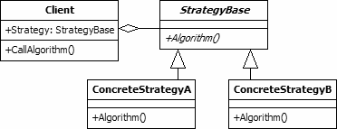
UML class diagram
Client. This class is the user of an interchangeable algorithm. The class includes a property to hold one of the strategy classes. This property will be set at run-time according to the algorithm that is required.
StrategyBase. This abstract class is the base class for all classes that provide algorithms. In the diagram the class includes a single method. However, there is no reason why a number of properties and methods may not be included. This class may be implemented as an interface if it provides no real functionality for its subclasses.
ConcreteStrategy A/B. The concrete strategy classes inherit from the StrategyBase class. Each provides a different algorithm that may be used by the client.

Slide 6
STRATEGY
Open/Closed principle
Behaviors of a class should not be inherited. Instead they should be encapsulated using interfaces.
Classes should be open for extension but closed for modification.
The strategy pattern uses composition instead of inheritance.
Behaviors are defined as separate interfaces and specific classes that implement these interfaces.
Allows better decoupling between the behavior and the class that uses the behavior.
Behaviors can be changed at run-time as well as at design-time.

Slide 7


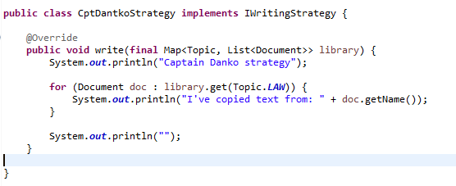
STRATEGY
Example strategy implementation
Create strategy interface
Create concrete strategies

Slide 8
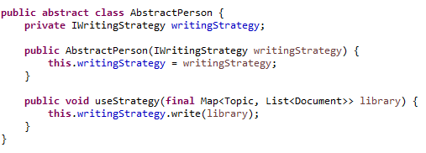

STRATEGY
Example implementation of clients
Create abstract client
Create concrete clients

Slide 9
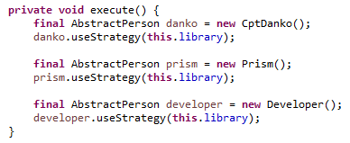
STRATEGY
Execute client’s strategy

Slide 10
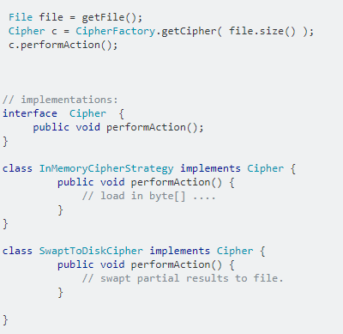
STRATEGY
Real world examples

Slide 11
STRATEGY
Java 8 Functional Interfaces
It is not hard to find more examples of the Strategy design pattern in the JDK, and it is even simpler starting from version 8. Making a quick reference search for the new functional interfaces (Predicate, Function, Consumer, Supplier etc) makes it clear that this pattern is used literally everywhere.
Just one example: ArrayList defines a method forEach, that takes as parameter a Consumer. The ArrayList class has no knowledge of the specific Consumers, it is only aware of the interface. The client of the collection has the responsibility to pass in the desired implementation of that interface. Of course, these Consumers usually do not manifest as a class, but are rather represented as lambda expressions.
HashMap and ConcurrentHashMap also rely heavily on the functional interfaces Function and BiFunction for computing and merging entries.

Slide 12
STRATEGY
Sources
https://en.wikipedia.org/wiki/Strategy_pattern
https://dzone.com/articles/design-patterns-in-the-real-world-strategy
http://www.blackwasp.co.uk/gofpatterns.aspx

Slide 13
STRATEGY
Questions and discussion

